Slide 1
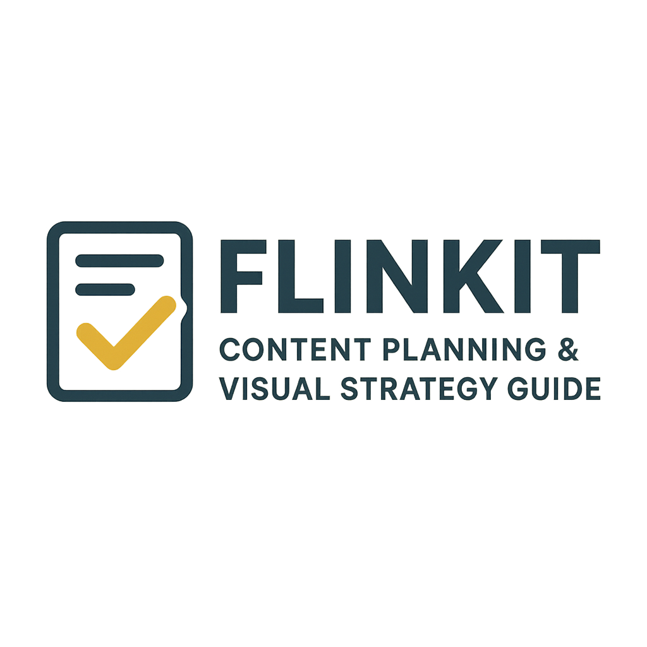



Slide 2
What is Flinkit?
Flinkit is a browser-based, AI-powered gamification platform, ideal for team-building, city tours, conferences, and educational purposes — no app download required. It offers features like AI-generated maps, over 5,000 game modes, indoor/outdoor adaptability, and simultaneous large-scale game hosting. It’s designed for both manual and automatic game creation in about five minutes.
Target users: Resellers (e.g., tour operators, museums), corporate HR, event planners, and remote/distributed teams.

Slide 3
PROBLEM STATEMENT
Here are some possible problem statements for "Flinkit Content Planning & Visual Strategy Guide":
1.Lack of Structured Content Planning: Many businesses struggle to create a consistent content roadmap, leading to irregular posting and missed engagement opportunities.
2.Ineffective Visual Strategies: Brands often fail to use visuals strategically, resulting in content that lacks appeal, coherence, and alignment with brand identity.
3.Time-Consuming & Unorganized Workflow: Teams waste valuable time switching between tools and processes, slowing down campaign execution and reducing productivity.
4.Difficulty in Aligning Content with Goals: Content is often created without a clear link to business objectives, leading to low ROI and poor performance tracking.

Slide 4
OBJECTIVES
Here are some clear objectives for "Flinkit Content Planning & Visual Strategy Guide":
1.Align Content with Business Goals: Bridge the gap between marketing efforts and business objectives, ensuring every piece of content serves a purpose.
2.Boost Audience Engagement: Create content that resonates with target audiences, improving reach, retention, and interaction.
3.Maintain Brand Consistency: Develop unified guidelines for visuals, tone, and messaging to create a recognizable brand identity.
4.Enable Data-Driven Decisions: Establish measurable KPIs and performance tracking methods to optimize future campaigns.
5.Support Scalable Growth: Build a strategy that adapts to evolving trends, audience needs, and business expansion.

Slide 5
APPROACH
Here are some approaches for "Flinkit Content Planning & Visual Strategy Guide":
1. Research & Insights:
Conduct audience research to understand preferences, behavior, and content consumption patterns.
Analyze competitors’ strategies to identify gaps and opportunities.
Use data-driven insights to set content priorities.
2. Content Framework Development:
Create a content calendar that aligns with campaigns, seasons, and business goals.
Define themes, formats, and publishing frequency.
Establish workflows with clear roles and responsibilities.
3. Visual Strategy Integration:
Develop brand visual guidelines (color palette, typography, imagery style).
Incorporate storytelling through visuals (infographics, reels, illustrations, videos).
Ensure consistency across social media, website, and offline materials.

Slide 6
1. Homepage
Intro to Flinkit
Highlights of the guide
Key CTAs (Explore Guide, Resources, Contact)
2. About
What is Flinkit?
Problem Statements & Objectives
Why content & visual strategy matter
3. The Guide
Content Planning(frameworks, calendar, workflow)
Visual Strategy (branding, storytelling, case studies)
Tools & Resources(templates, recommended tools, downloads)
4. Approaches & Methodology
Research & Insights
Strategy Development
Optimization & Tracking
5. Blog / Insights
Articles
tips
case studies
6. Resources / Downloads
Free templates
infographics
e-books
7. Contact / Support
Contact form
FAQs
helpdesk
social media
8. Footer
Quick links
social media
privacy & terms
TASK 1 – CREATE A WEBSITE STUCTURE

Slide 7
TASK 2 - TOPIC IDEAS
Blog Ideas (as many as possible)
Why Every Brand Needs Flinkit for Content Planning
Step-by-Step Guide to Creating a Content Calendar
Visual Storytelling with Flinkit: How to Stand Out
Flinkit’s Approach to Aligning Content with Business Goals
Top 10 Tools to Use Alongside Flinkit
How Visual Identity Impacts Brand Growth
Content Repurposing: Maximizing Your Work with Flinkit
Case Studies: Brands That Nailed Their Strategy
AI in Content Planning: How Flinkit Stays Ahead
The Psychology of Colors & Visuals in Marketing
Beginner’s Guide: Planning Social Media with Flinkit
Advanced Workflow Hacks with Flinkit
Common Content Mistakes Flinkit Helps You Avoid
Data-Driven Content Strategy with Flinkit Analytics
Building a Scalable Team Workflow with Flinkit
Products Flinkit Should Offer
Content Calendar Templates (monthly, quarterly, yearly)
Visual Branding Kits (logos, fonts, color palettes)
Infographic Templates
Social Media Post Packs (Instagram, LinkedIn, etc.)
Presentation Deck Templates (strategy reports, client pitches)
Content Planning Toolkit (bundle of all resources)
Flinkit E-book (complete guide)
Workshops & Webinars (live training)
Consulting Services (custom strategies)
AI-Powered Content Prompts Pack
Product Categories
Templates (Calendars, Infographics, Social Media, Presentations)
Guides & E-books
Toolkits & Bundles
Workshops & Training
Consulting Services
AI Content Packs

Slide 8
TASK 3 - PICKING UP THE PAGES
1. Blog Page Idea
Title: “Step-by-Step Guide to Creating a Content Calendar with Flinkit”
Overview: This blog will walk readers through the process of building a content calendar using Flinkit’s
framework. It will show why planning is critical, provide examples, and offer templates.
Topics inside the blog:
Why a Content Calendar is Essential
Tools You Can Use (including Flinkit Templates)
Step 1 – Define Goals & Audience
Step 2 – Choose Content Formats & Channels
Step 3 – Map Content to Dates & Events
Step 4 – Assign Roles & Deadlines
Step 5 – Track & Optimize Performance
Free Download → Flinkit Content Calendar Template (CTA)

Slide 9
2. Product Page Idea
Product: Flinkit Content Calendar Templates
Sections on the page:
Headline: Plan Smarter with Flinkit Content Calendar Templates
Description: Professionally designed monthly, quarterly, and annual content calendars to simplify planning.
Features:
Ready-to-use & editable (Excel, Google Sheets, Notion)
Built-in tracking & KPIs
Color-coded for easy navigation
What’s Included:
Monthly Calendar Template
Quarterly Campaign Planner
Annual Marketing Roadmap
CTA: [Download Now] or [Get the Bundle]

Slide 10
3. Product Category Page Idea
Category: Flinkit Templates (Calendars, Infographics, Social Media, Presentations)
Sections on the page:
Intro: All-in-one creative templates to power your content & visuals.
Subcategories:
Infographics → Data storytelling made simple.
Social Media Packs → Pre-designed posts for Instagram, LinkedIn, etc.
Presentation Decks → Strategy reports, pitches, client-ready slides.
Calendars → Plan campaigns with ease.
Features:
Editable & customizable
Designed for efficiency
Compatible with Canva, PowerPoint, Google Slides

Slide 11
TASK 4 - CONTENT STRUCTURE
1. Blog Page Content Structure
Title: Step-by-Step Guide to Creating a Content Calendar with Flinkit
Structure:
Hero Section
Title + Engaging intro
Featured image (calendar/visual planning graphic)
Introduction
Why planning matters
Benefits of using a content calendar
Main Content (Step-by-Step)
Step 1: Define goals & audience
Step 2: Select content types & channels
Step 3: Map content to dates/events
Step 4: Assign roles & deadlines
Step 5: Track performance & optimize
Best Practices & Tips
Keep flexibility for trends
Repurpose high-performing content
Integrate visuals strategically
Call-to-Action
Download Flinkit’s free Content Calendar Template
Link to Product Page: Content Calendar Templates

Slide 12
2. Product Page Content Structure
Product: Flinkit Content Calendar Templates
Structure:
Hero Section
Product name + tagline (“Plan Smarter, Execute Better”)
CTA button: [Download Now]
Product Overview
Short description of what the templates are
Who it’s for (marketers, creators, teams)
Key Features
Ready-to-use (Excel, Google Sheets, Notion)
Monthly, quarterly, annual versions
Built-in KPIs & campaign tracking
Editable & customizable
What’s Inside
Monthly Content Calendar
Quarterly Campaign Planner
Annual Roadmap
What’s Inside
Monthly Content Calendar
Quarterly Campaign Planner
Annual Roadmap
Benefits (Why Choose Flinkit)
Saves time
Keeps teams aligned
Improves campaign performance
Visuals / Screenshots (sample preview of templates)
Pricing / Download Options
Free starter version
Premium bundle

Slide 13
3. Product Category Page Content Structure
Category: Flinkit Templates (Calendars, Infographics, Social Media, Presentations)
Structure:
Hero Section
Title: “All-in-One Content & Visual Templates”
Subtitle: Ready-made resources to plan, design, and deliver impactful content.
Category Introduction
Why templates are important
How Flinkit simplifies strategy execution
Template Categories
Calendars → Plan campaigns with ease (link to product page)
Infographics → Turn data into stories
Social Media Packs → Pre-designed Canva/PSD templates
Presentation Decks → Strategy & pitch-ready slides
Key Benefits
100% customizable
Time-saving
Brand-consistent design
Featured Products / Previews
Showcase thumbnails of top templates
CTA Section
[Explore All Templates]
Link to individual product pages

Slide 14
TASK 5 - COMPETITIVE ANALYSIS
1) Real SERP competitors (high-intent pages)
These are the pages that currently satisfy the same intent your guide targets:
HubSpot – Content Strategy (7 steps) + free kits/templates (evergreen hub + offers).
Content Marketing Institute – 4-part guide to crafting a content plan (authoritative how-to, Feb 29, 2024).
Hootsuite – Social media content calendar (guide + template) (updated ~3 months ago).
Asana – Social media/content calendar template (bottom-funnel template + explainer).
Kinsta – Visual content strategy (SEO blog framing visuals for traffic growth).
Wix SEO hub – Visual content marketing 101 (platform-led visual strategy primer).
Canva – Visual marketing strategy guide (design-led, visuals + execution).

Slide 15
Column Five – Ultimate guide to visual content marketing (agency thought leadership).
TechRadar – Best content calendar software (2025) (tool evaluation capturing “calendar” intent).
Emplifi / The Blog Social – 2025 social dates & calendars (seasonal/calendar keyword capture).
2) What they’re ranking for (themes & likely keywords)
From H1/H2s, offers, and on-page copy, these pages collectively target:
Head terms : “content strategy,” “content plan,” “content planning,” “visual content strategy,”
“content calendar,” “social media content calendar.”
Mid/long-tails : “content strategy template,” “content planning template,” “content calendar
template,” “how to create a content calendar,” “visual marketing strategy,”
“visual content examples,” “visual content examples,”
Seasonal/tool intent: “2025 social media calendar,” “best content calendar/software,”
“key dates for social calendar.”

Slide 16
3) Competitor strengths & weaknesses (how Flinkit can win)
HubSpot
✅ Strengths: Authority, huge content hub, free templates.
❌ Weaknesses: Generic focus, visuals not central.
Content Marketing Institute (CMI)
✅ Strengths: Trusted, editorially strong, clear process.
❌ Weaknesses: Few templates, little visual-first strategy.
Hootsuite / Asana
✅ Strengths: Great calendar templates, strong social focus.
❌ Weaknesses: Limited to social media, not full content/visual planning.
Canva / Wix / Column Five / Kinsta
✅ Strengths: Visual-first, strong design insights & examples.
❌ Weaknesses: Light on planning workflows & KPIs.
TechRadar / Emplifi (Tools & Dates sites)
✅ Strengths: Capture seasonal/calendar queries, tool roundups.
❌ Weaknesses: Not strategic, shallow content.

Slide 17
4) Keyword gap ideas for Flinkit (angles competitors under-serve)
“Visual content planning” and “visual content calendar” as exact phrases (most guides split “visual” and “planning”). Build pages: /visual-content-planning/, /visual-content-calendar-template/. (Inferred gap across competitors above.)
Cross-channel visual systems: “brand visual system,” “design system for content,” “content style tile,” tied to planning workflows (rare outside Canva/agency articles).
Measurement for visuals: “visual content KPIs,” “how to A/B test thumbnails,” “creative scorecards” (light coverage in competitors). (Inference from limited KPI detail in cited guides.)
AI in planning visuals (2025): “AI content calendar,” “AI for visual content planning,” “AI brand guardrails for creatives”—trending and thinly covered in top guides. (Supported by broader 2025 visual-communication trend pieces.)
Sector templates: “visual content plan for ecommerce/B2B/SaaS/education” variants—competitors offer generic templates.

Slide 18
5) Your “Top Pages” blueprint (to compete & capture clusters)
Create a small cluster so your guide can rank + convert:
Pillar: Flinkit Content Planning & Visual Strategy Guide (H1: “Content Planning & Visual Strategy: The 2025 Playbook”)
Subheads covering research → visual system → plan → create → publish → measure; embed an interactive content calendar and downloadable kit. (Out-depth HubSpot/CMI with visuals + ops.)
Templates Hub: Content & Visual Calendar Templates (Google Sheets/Notion/Asana/Excel)
Capture “content calendar template” + “visual content calendar” and “2025 social dates.”
Visual System Guide: Brand Visual System for Content Teams (with style tiles + examples)
Competes with Canva/Column Five; adds operations checklists.
Measurement: Visual Content KPIs + Creative Testing Framework
Own the “measure visuals” gap (thumb tests, brand lift, CTR, save/share rate).
AI Ops: AI-Assisted Content Planning (Guardrails, Prompts, Workflows)
Leverage 2025 trend coverage to rank for “AI content calendar/planning.”

Slide 19
6) Recommended target keyword set (start list)
Primary: content planning; content plan; content strategy; visual content strategy; content calendar; social media content calendar; content strategy template.
Secondary: visual marketing strategy; content calendar template; 2025 social media calendar; content planning template; content planning process; content style guide; visual content examples.
Opportunity long-tails: visual content calendar template; brand visual system for content; AI content calendar; content KPI dashboards; creative testing for thumbnails.
7) On-page outline to outrank
Title tag: Content Planning & Visual Strategy Guide (2025) — Templates, Calendar & KPIs
H1: Content Planning & Visual Strategy: The 2025 Playbook
Key sections: Research → Audience & Messaging → Visual System (palette, typography, motion rules) → Planning (cadence, calendar, Notion/Asana embeds) → Production SOPs → AI workflows → Measurement (KPIs/tests) → Case examples.

Slide 20
Assets: free visual content calendar (Sheets/Notion), style-tile template, KPI dashboard starter.
8) Quick technical + content moves
Intent coverage: Add separate pages for “visual content calendar template” and “AI content calendar” to catch long-tails competitors miss.
Schema: Article + HowTo for steps; SoftwareApplication if you provide a live calendar tool.
Internal links: Pillar → templates → measurement; cross-link with strong anchors (“visual content calendar template,” etc.).
Freshness: Update dates/seasonal hooks quarterly (e.g., new 2026 dates when they roll out). Emplifi/TechRadar pages show that freshness wins for calendar/tool queries.

Slide 21
TASK 6 - KEYWORD RESEARCH
keyword research of the “Flinkit Content Planning & Visual Strategy Guide”: a blog page, a product page, and a product category page:
A Few Quick Questions to Get Started:
What type of product or service does Flinkit offer?
Is this a SaaS tool for content planning? A visual design platform? Something else?
Could you share the intended focus or description of each page?
For example: what is the main topic or value proposition of the blog page?
What does the product page promote—features, pricing, audience?
What categories or themes are covered by the product category page?
Who is the target audience?
Are we aiming at content managers, visual strategists, marketers, or other users?

Slide 22
How I’ll Use This Info:
Draft appropriate keyword research strategies using Google and reputable keyword tools.
Suggest relevant, high-impact keywords that align with SEO best practices and intent-based optimization for each page type.
If you prefer, I can generate potential keyword themes even with hypothetical product details—you can refine them later.

Slide 23
TASK 7 - ON-PAGE ELEMENTS
Here’s a polished, structured breakdown of on-page SEO elements you should optimize for each of your three pages—blog, product, and category—within the Flinkit Content Planning & Visual Strategy Guide.
Key On-Page SEO Elements (Unified Checklist)
Drawing from reputable sources, the essential on-page SEO elements include:
Keyword Strategy
Keyword Research: Identify focus and related long-tail keywords tailored for each page type using tools like Google Keyword Planner, Ahrefs, Moz, Keyword Tool.io, etc.
Placement: Incorporate keywords naturally in titles, headers, first paragraphs, body, meta tags, and image alt text.
2. HTML Elements
Title Tag (Meta Title): Unique, keyword-rich, and under ~60 characters.

Slide 24
Meta Description: Compelling, includes keywords, crafted for CTR, ~70–160 characters.
Headers (H1, H2, H3…): One H1 focusing the main keyword; H2s and H3s structure content
Image Alt Text & Filenames: Descriptive, keyword-friendly, and under ~125 characters; also compress and use proper formats.
Structured Markup (Schema): For articles, products, FAQs—boosts SERP visibility.
3. URL & Site Architecture
Clean URLs: Short, descriptive, hyphenated, keyword-inclusive.
Internal Linking: Guide users/search crawlers to related pages within your site
4. Content Quality & Structure
High-Quality Content: Valuable, readable, authoritative (E-A-T).
Content Structure: Use paragraphs, lists, bolding, FAQs, tables, CTAs, and readability enhancements.

Slide 25
5. Performance & Mobile Optimization
Mobile-Responsiveness: Ensure the site works seamlessly on mobile.
Site Speed & Core Web Vitals: Optimize LCP (under 2.5s), INP, CLS; fast-loading enhances UX.

Slide 26
TASK 8 - EXAMPLE BLOG
*Here’s a 300-word blog-style paragraph on “Flinkit Content Planning & Visual Strategy Guide,” complete with incorporated target keywords and annotated on-page elements use for optimization:
Flinkit’s Content Planning & Visual Strategy Guide empowers content creators and marketing professionals with a structured yet flexible approach to crafting compelling visual content.
At its core, the guide helps you define your content strategy goals, understand your target audience, and align your visual content planning with business objectives, echoing industry-standard frameworks .
By leveraging visual roadmaps, you can transform scattered ideas into cohesive workflows—enhancing cross-functional alignment, agility, and streamlined content creation processes.
Incorporating a strong mix of infographics, videos, branded visuals, and memes or quotes not only reinforces brand identity but also boosts audience engagement and shareability .
Prioritizing consistency in design elements and distribution platforms ensures that your visual strategy reinforces your brand voice across channels .

Slide 27
The guide suggests using tools such as Mural for creating dynamic, collaborative roadmaps, enabling real-time adjustments and team participation .
Additionally, integrating keyword-informed content planning—built around terms like “visual strategy content planning,” “content planning tools,” and “visual roadmap strategy”—ensures discoverability and SEO effectiveness .
Ultimately, Flinkit’s guide serves as a blueprint for building a visual content strategy that’s not only visually appealing but also strategically sound—driving deeper engagement, stronger brand trust, and measurable results.

Slide 28
On-Page SEO Elements Used:
Title tag (H1): Flinkit Content Planning & Visual Strategy Guide – keyword-rich and clear focus.
Meta description: “Explore Flinkit’s Content Planning & Visual Strategy Guide to learn visual roadmap planning, infographics, videos, and consistent brand visuals for engaging content.”
Headers:
H1: Flinkit Content Planning & Visual Strategy Guide
H2: Why Visual Roadmaps Matter
H2: Choosing Visual Content Formats
H2: Consistency & Tools for Collaboration
URL structure: /blog/flinkit-content-planning-visual-strategy-guide
Image alt text (for visuals such as infographics, roadmaps): “Visual content roadmap example from Flinkit guide” or “Infographic planning visual strategy”
Internal linking: Link to related content planning tools page, product pages for planning templates, or category pages about content strategy.

Slide 29
Schema markup: Use Article schema (for blog content), potentially FAQ schema if FAQs are added later.
Keyword usage: Primary keywords “content planning & visual strategy,” “visual roadmap strategy,” “visual content planning.”
Content format: Rich paragraph with keywords, citations, clear structure; could be enriched with bullet lists, CTAs (“Download the guide,” “Try Flinkit’s template”), maybe an embedded infographic.
Mobile responsiveness & speed: Ensure the blog page loads quickly, images are optimized/compressed, and it renders well on mobile.
Word count: ~300 words to satisfy content depth.

Slide 30
CONCLUSION AND TAKEAWAYS
Here’s a refined breakdown, drawing on trusted sources, to demonstrate how the “Flinkit Content Planning & Visual Strategy Guide” project deepened your understanding of SEO objectives—and how we can apply that knowledge to drive your digital marketing goals.
How This Project Enhanced SEO Insight
Working on the Flinkit Content Planning & Visual Strategy Guide clarified several foundational principles of SEO strategy:
SEO Goals Define the Path, Strategy Guides the Journey Understanding that clear goals are essential—they act like a GPS directing the strategy, while on-page tactics and content execution form the actionable route.
Setting SMART SEO Goals Makes Strategy Actionable The project reinforced the need for goals that are Specific, Measurable, Achievable, Relevant, and Time-bound. This framework ensures you stay focused and can accurately measure progress—whether targeting keyword rankings, traffic, or conversions

Slide 31
SEO Objectives Align with Business KPIs SEO isn't just about traffic or ranks—it’s about driving real business outcomes, such as lead generation, brand visibility, and e-commerce, depending on the context of your guide.
SEO Strategy Must Incorporate Content Value and Technical Structure Planning visual content and structuring your guide emphasized best practices like organizing pages, using descriptive URLs, and crafting compelling content—elements highlighted in Google’s SEO Starter Guide.
2. Applying SEO Knowledge to Achieve Digital Marketing Goals
Here’s how you can translate that SEO foundation into actionable digital marketing tactics:
Set Clear, Business-Aligned SEO Objectives
Define goals such as:
Increase organic traffic by X% over Y months.
Improve rankings for target keywords.
Generate qualified leads or revenue from content-driven SEO activities.

Slide 32
These should be specific and measurable, aligning with overall marketing targets.
Build a Data-Informed SEO Strategy
Conduct keyword and SERP research to find high-potential search opportunities and relevant user intents.
Map out a strategic content plan—organizing topics topically (pillar pages, blogs, visuals) to drive both SEO benefits and narrative coherence.
Optimize Content for Search Engines and Users
Ensure strong on-page SEO: use descriptive URLs, headers, meta descriptions, and high-quality visual assets as in the guide creation.
Incorporate formatting elements such as visual roadmaps and infographics to improve clarity and engagement.

Slide 33

Reinforce Credibility with Backlinks
Develop a link-building strategy to boost domain authority and referral traffic—backlinks remain a key ranking factor.
Monitor, Refine, and Adapt
Use tools like Google Analytics, Search Console, and advanced platforms (e.g., Semrush, Ahrefs) for performance tracking, audits, and competitor insights .
Continuously refine your strategy based on data—adjust underperforming content, optimize for new keywords, and ensure long-term value.

